Slide 1
Technology for Success: Computer Concepts

Slide 2
Module 7
Digital Media

Slide 3
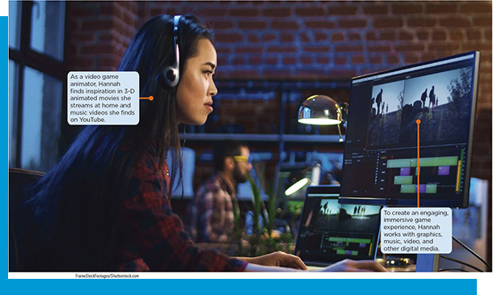
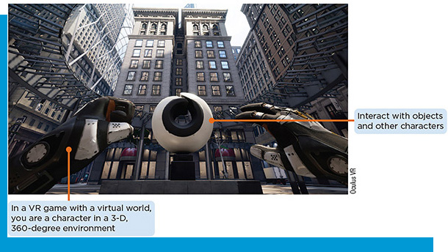
Lesson Objectives
Explain how computers use digital media and graphics to represent the real world
Demonstrate the ability to use varied sources of digital media
Record and edit digital media

Slide 4
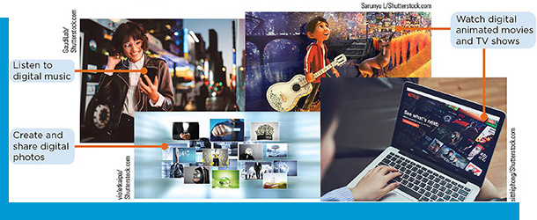
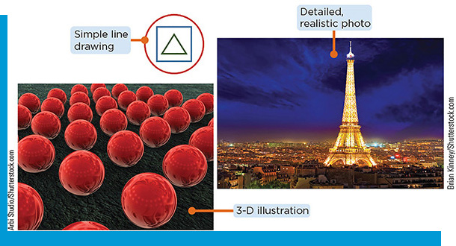
How Digital Media Represents the Real World
Define digital media concepts
Define digital graphics
Describe how computers represent images and sounds
Identify digital media file formats
Compare 2-D and 3-D animation

Slide 5
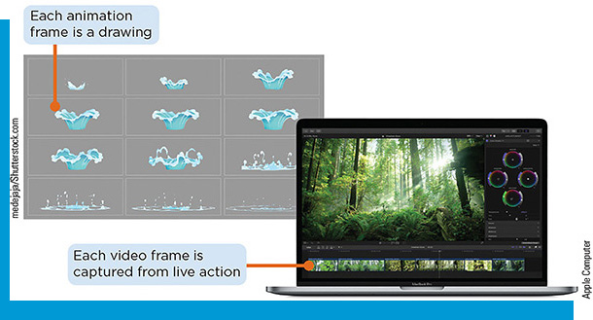
Digital Media Concepts
Computers generate, display, distribute, and play digital media
Graphics
Animation
Video
Audio
Virtual reality

Slide 6
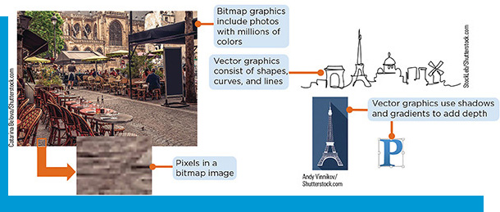
Define Digital Graphics
Digital graphic: an image you can see, store, and manipulate on a computer or digital device
Bitmap graphics: assign colors to pixels
Vector graphics: shapes, curves, lines, and text created by mathematical formulas
Properties that affect quality
Resolution
Compression
Lossy compression
Lossless compression

Slide 7
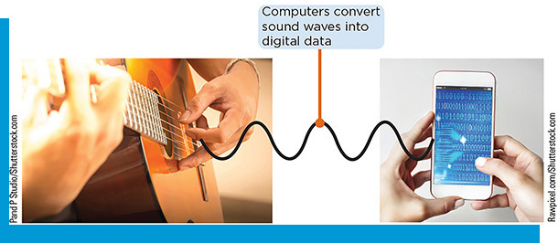
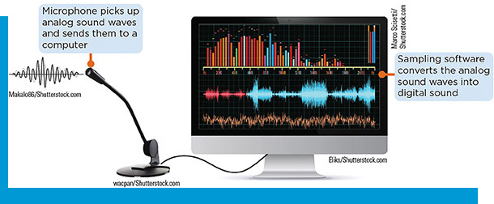
How Computers Represent Images and Sounds
Analog devices: read or produce physical signals in their original form
Digital devices: read and produce numeric data as combination of 1s and 0s
Binary number system
Bit/Byte
Digitizing: converting analog to digital data
Sampling: converts analog sound waves to digital sound
Bit rate determines audio quality

Slide 8
Digital Media File Formats (1 of 5)
Table 7-1: Common Graphics File Formats
Graphic file format | File extension | Best use / Notes
Bitmap graphics
G I F | .gif (Graphics Interchange Format) | Simple web graphics and short web animations Format is limited to 256 colors; supports transparency; small file size makes it good for websites
J P E G | .jpeg or .jpg (Joint Photographic Experts Group) | Photos on the web Images have rich colors, but discard some data to reduce file size, which can affect quality
P N G | .png (Portable Network Graphics) | Logos, icons, and illustrations Images have good quality even when highly compressed; supports 16 million colors; better quality and smaller file size than GIF
T I F | .tif or .tiff (Tagged Image File Format) | High-quality photos and printed graphics Large file size is better suited for print than web use
Vector graphics
E P S | .eps (Encapsulated PostScript) | Logos and other illustrations that are frequently resized A standard format for exporting vector graphics without data loss
S V G | .svg (Scalable Vector Graphics) | Illustrations on the web Developed by the World Wide Web Consortium (W3C); allows interactivity and animation

Slide 9
Digital Media File Formats (2 of 5)
Table 7-2: Common Audio File Formats
File format | File extension | Compression | Notes
A A C and M4P | .aac and .m4p | Lossy | Apple uses these formats for iTunes downloads
A I F F (Audio Interchange File Format) | .aiff or .aif | None | Files are large; good to excellent sound quality
MP3 | .mp3 | Lossy | Common format for music and audio books; most digital audio devices can play MP3 files
WAVE or WAV (Waveform Audio) | .wav | None | Files are large; good to excellent sound quality
W M A (Windows Media Audio) | .wma | Lossless | Played using Windows Media Player; also copy-protected

Slide 10
Digital Media File Formats (3 of 5)
Table 7-3: Common Video Codecs
Name | Compatible with | Best use / Notes
DivX | A V I video container | Commercial video production Provides the highest video quality at the expense of file size
H.264 | MP4 video container | Playing on playback devices or streaming services Common, efficient codec; preferred for YouTube videos
H.265 | MP4 video container | Very high resolution videos New video codec; also called H E V C
M P E G-2 | MP4 and Quicktime containers | D V Ds, Blu-ray discs, professional-grade cameras Not used for streaming services
M P E G-4 | Wide range of compatibility | Online streaming services Common codec providing good quality

Slide 11
Digital Media File Formats (4 of 5)
Table 7-4: Common Graphics File Formats
Name | File size and quality | Best use / Notes
A V I (.avi) | Files are often larger than others | Videos to store on a computer One of the oldest and most accepted formats
MP4 (.mp4) | Relatively small files and high quality | Nearly universal Websites such as YouTube and Vimeo prefer MP4 files
Quicktime (.mov) | Large files with high quality | Playback on Apple devices Developed by Apple
Windows Media (.wmv) | Small file size with reduced quality | Sharing with others and posting on the web Developed by Microsoft

Slide 12
Digital Media File Formats (5 of 5)
Video File Resolutions
Standard Definition (S D): 640 × 360 and 720 × 480
High Definition (H D): 1280 × 720 (720p) and 1920 × 1080 (1080p or Full H D)
Ultra High Definition (U H D): 3840 × 2160 (2160p), 4K standard; 7840 × 4320 (4320p), 8K standard
In most cases, Full H D balance high-quality playback with smaller file sizes that download quickly

Slide 13
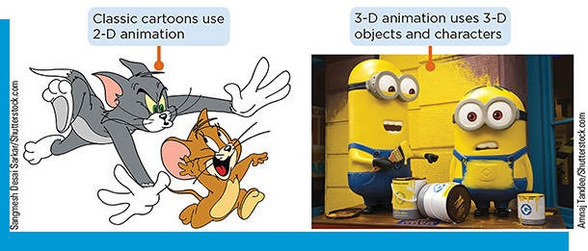
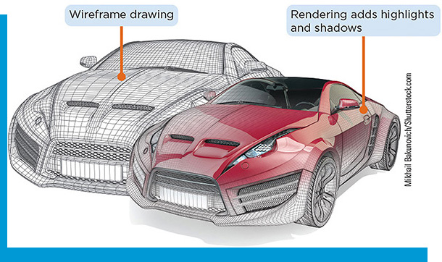
Compare 2-D and 3-D Animation
2-D animation displays 2-D images in rapid sequence to create the illusion of lifelike motion
In-betweening
3-D animation displays 3-D objects or models in rapid sequence to create the illusion of natural motion
Have volume and can rotate 360 degrees
Rendering: apply highlights and shadows to a wireframe drawing
Keyframe
Stop motion animation

Slide 14
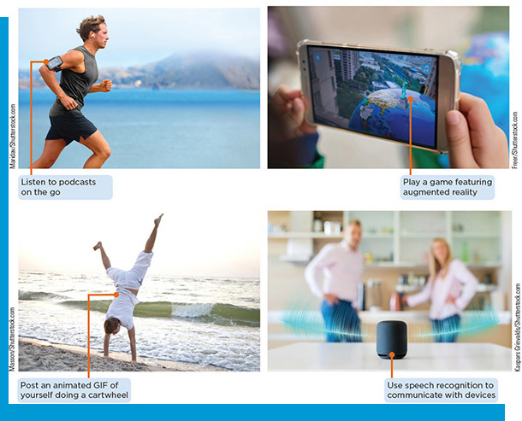
Using Varied Sources of Digital Media
Use gaming systems
Use animations across digital media platforms
Use graphics across digital media platforms
Use computer-aided technology across digital media platforms
Stream digital media

Slide 15
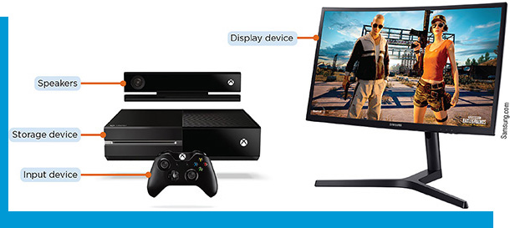
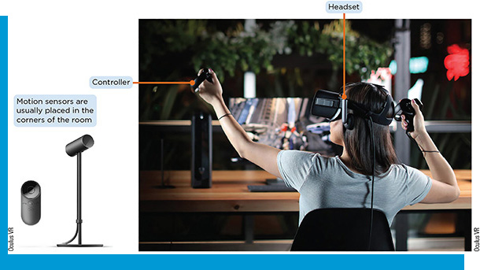
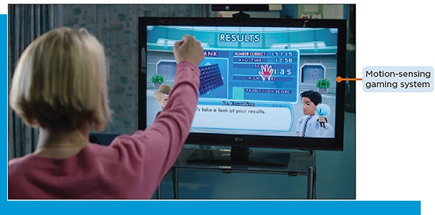
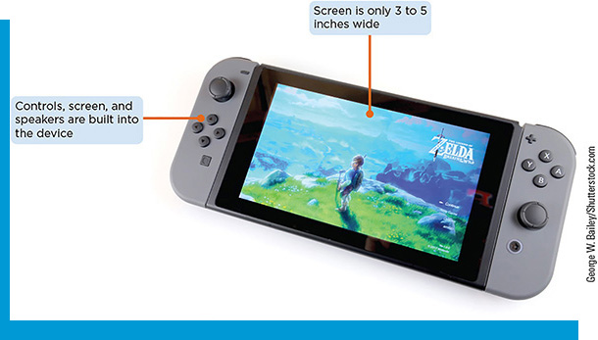
Use Gaming Systems (1 of 2)
Set Up a Gaming System
Most games are played on game consoles
V R gaming system: run on desktops and include a headset, controllers, and sensors to track movements
Mixed reality
Holograms
Motion-sensing game consoles

Slide 16
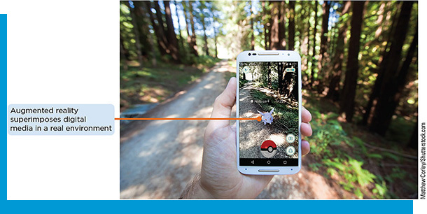
Use Gaming Systems (2 of 2)
Mobile Gaming
Self-contained portable devices that fit in one hand
The first to popularize augmented reality (A R) gaming

Slide 17
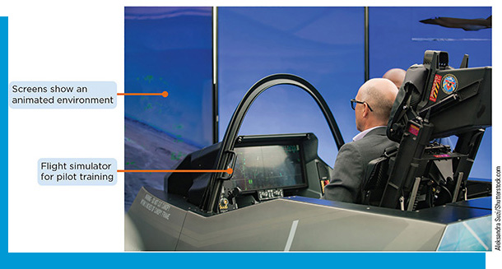
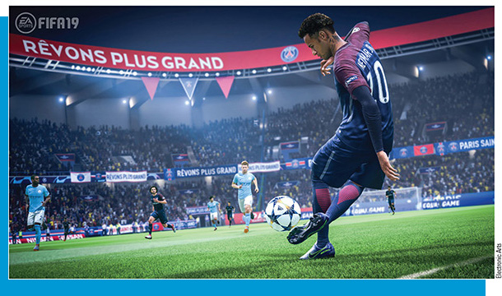
Use Animations Across Digital Media Platforms
Simulations: sophisticated computer animations that are useful for training and teaching
PowerPoint transitions: a simple use for animation
Animations on the Web
Animated G I F
HTML 5: does not require plug-in software (Flash)
Animations in Entertainment
Real-time animation

Slide 18
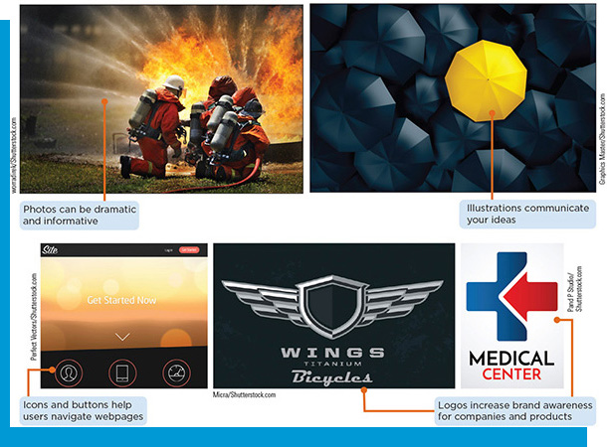
Use Graphics Across Digital Media Platforms
Use graphics to add dramatic or informative photos
Logos on business documents and websites increase brand awareness
Online stock photo galleries provide graphics that can be downloaded, using for a fee
Search engines provide a license filter to find images that can be used legally

Slide 19
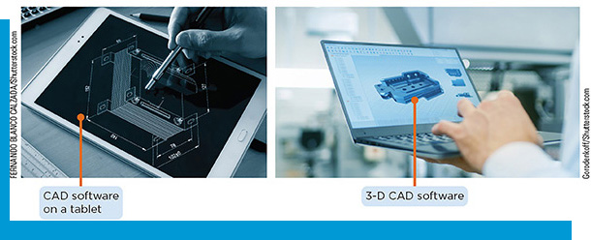
Computer-Aided Technology Across Digital Media Platforms
Uses computers to help design, analyze and manufacture products
Computer-aided design (C A D) software creates highly detailed and technically accurate drawings
3-D C A D software creates wireframe drawings
Uses artificial intelligence (A I) to help automate design tasks
Machine learning: a branch of AI that trains machines to learn from data, identify patterns, and make decisions to progressively improve performance

Slide 20
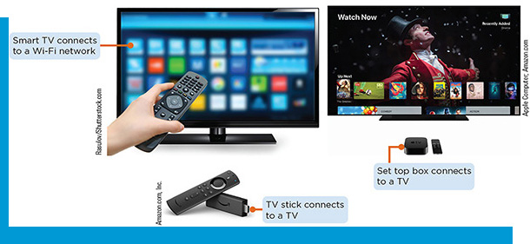
Streaming Digital Media
Receiving audio or video content on your computer from a server
On-demand content
Live video streaming
Smart T Vs and streaming devices
Smart T Vs: connect to a wi-fi network to view Internet content
T V stick/set-top box: allows the streaming of T V shows and movies from subscription services
Stream digital audio
Live audio feeds

Slide 21
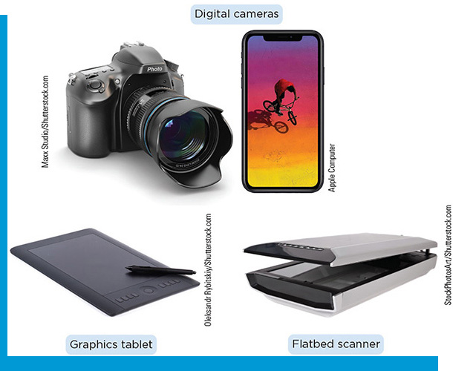
Record and Edit Digital Media
Create graphics and animation
Record and play sounds and music
Develop original videos
Edit digital media files

Slide 22
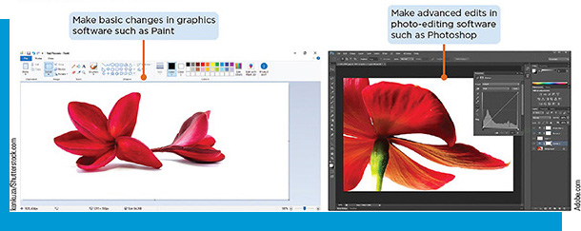
Create Graphics and Animation (1 of 2)
Hardware devices
Digital camera creates a digital image of an object, person, or scene
Smartphone camera provide geotagging
Use a graphics tablet to create drawings with a pressure-sensitive pen
Scanner converts a printed document into a bitmap file by diving the image into a grid of tiny cells and assigned colors to each cell

Slide 23
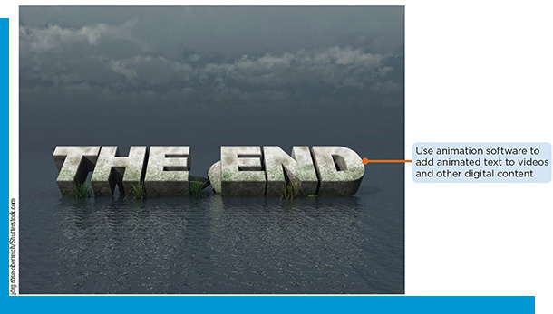
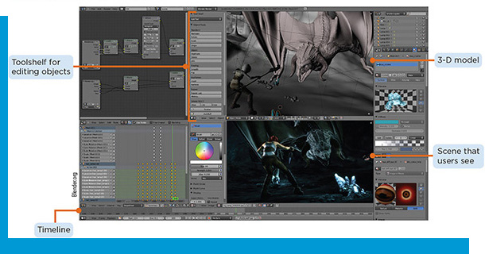
Create Graphics and Animation (2 of 2)
Graphics Software
Image-editing software: modify existing images
Drawing programs create simple vector images
Photo-editing software: enhance and retouch photographs
Animation software
Add animation to digital graphics and videos
Create animated content from scratch for cartoons, movies, games
Create and display animations for webpages

Slide 24
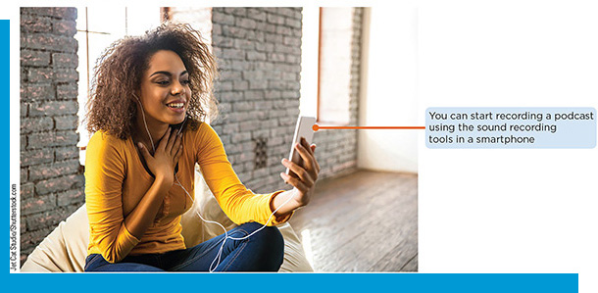
Record and Play Sounds and Music (1 of 4)
To record voice-overs and save recordings for playback on a computer the following is required:
An audio input device, such as a microphone or headset
Sound recorder software
Software that can digitize the captured sound or convert it
To play music files, the following is required:
A sound card
Speakers
Audio software
Some files require a stand-alone player

Slide 25
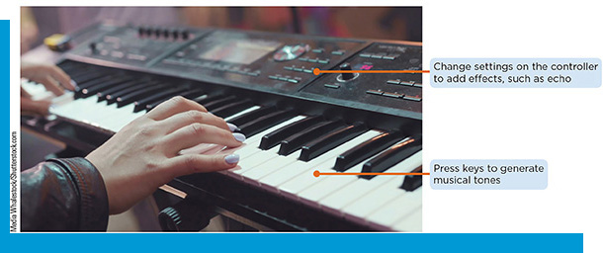
Record and Play Sounds and Music (2 of 4)
Use Synthesized Music
Created as a digital file from the start using electronic instruments
Musicians play synthesizers to mimic sounds from acoustic or electric instruments or to produce unusual sounds that other instruments cannot generate
M I D I (Musical Instrument Digital Interface) converts electric current to digital form

Slide 26
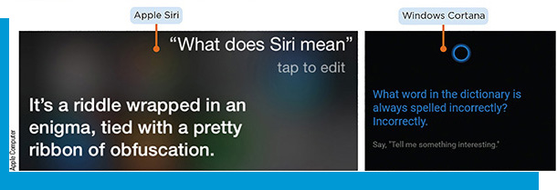
Record and Play Sounds and Music (3 of 4)
Speech and Voice Recognition Software
Speech recognition lets a device or software identify the words one speaks and converts them to a format the device can read
Digital assistants combine A I with speech recognition technology
Voice recognition determines who is speaker rather than what is being said; used as a security measure

Slide 27
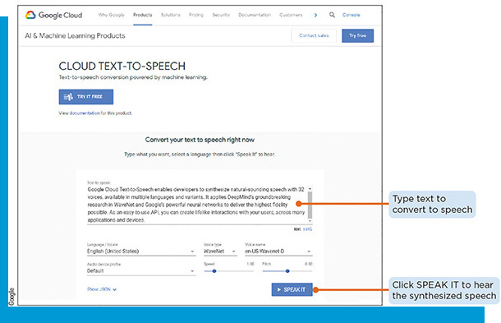
Record and Play Sounds and Music (4 of 4)
Use Synthesized Speech
Text-to-speech software accepts text as input and generates speech as output
Creates synthesized speech

Slide 28
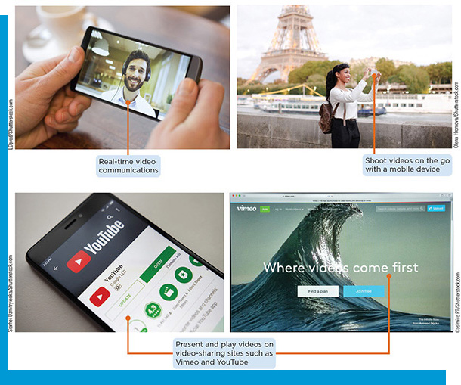
Develop Original Videos (1 of 3)
Capture Video
One can use a digital video camera, camcorder, or smartphone to capture full-motion images and store them in a file on the camera or phone
Webcams capture video and send it directly to a computer
Digital video files are large (1 to 30 G B for each hour of video)

Slide 29
Develop Original Videos (2 of 3)
Play Video
A screen, speakers, and a video card is required to watch video
Media player software is required
Digital video files are large (1 to 30 G B for each hour of video)

Slide 30
Develop Original Videos (3 of 3)
Access Video on the Web
Fast Internet connections have made watching videos on computers and mobile devices almost as popular as watching television
People use websites to share personal videos
Video conferencing is increasingly being used in business settings, as well as by friends and families

Slide 31
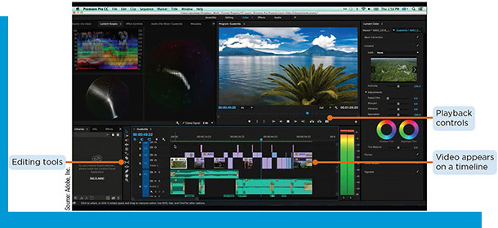
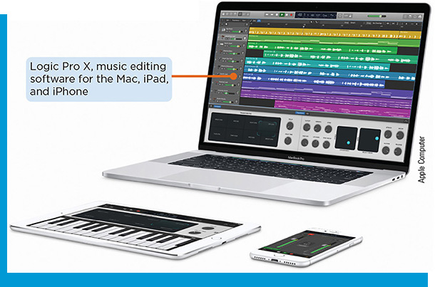
Edit Digital Medias Files
Video editing software allows one to enhance and customize video
Most software shows the video as a timeline with sperate tracks for video and sound
Audio capture and editing software allows one to edit, copy, and share digital audio files
Music production software lets one record, compose, mix, and edit music and sounds

